Slide 1
The methanol synthesis
Antal Tungler
Emeritus professzor
Centre for Energy Research
2024

Slide 2
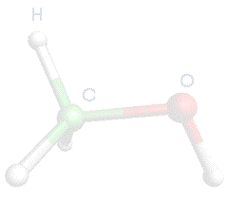
Contents:
BME
Introduction
  History of the methanol and it’s synthesis,
  Properties of the methanol
  it’s use
  The methanol as energy storage material
Methanol Production Processes
Type of reactors
Catalyst selection
New routes for the methanol synthesis
Storage and transportation
Environmental protection

Slide 3
BME
Introduction
. Methanol also known as methyl alcohol, carbinol, wood alcohol or
wood spirit, is a chemical compound with the chemical formula CH₃OH.
. It is the simplest alcohol and is a light, volatile, colorless, flammable
and poisonous liquid.
. Methanol is an often used solvent, future alternative fuel, energy storage material and it is also widely used as a raw material for the production of MTBE, biodiesel and other chemicals.
. The demand of this compound is increasing worldwide.

Slide 4
Physical properties
Molecular mass Critical temperature Critical pressure Threepoint temperature Threepoint pressure Boiling point Melting point Density Viscosity Solubility in water | 32.4 239.49°C 8.097 MPa -97.56°C 0.10768Pa 64.7°C -97.68°C 0°C 0.8100 g/cm³ 20°C 0.7913 g/cm³ 25°C 0.78664 g/cm³ Liquid 0.5513 mPa s Vapor 9.98× 10 –³ Miscible with water in every ratio

Slide 5
BME
History of the methanol
. Pure methanol, was first obtained in 1661 by Robert Boyle, who
called it spirit of box, because he produced it via the distillation of
boxwood.
. Mittasch and his coworkers prepared a methanol containing mixture from synthesis gas(CO+H₂) with Fe catalyst in 1913 at BASF.
In 1923, the German chemist Matthias Pier, working for BASF also,
developed a highly selective catalytic reaction to convert synthesis gas (a mixture of carbon monoxide and hydrogen derived from coke and used as the source of hydrogen in synthetic ammonia production) into methanol.
Pressure 25 – 35 MPa
Temperatures of about 400°C.
Catalyst ZnO/Cr₂O₃ on alumina

Slide 6
BME
. In 1966, ICI developed as first a route for methanol synthesis in which sulfur free synthesis gas (based on natural gas) containing a high proportion of carbon dioxide was reacted on highly selective copper oxide catalysts.
Pressure 5-10 MPa
Temperature between 200-300°C
Methanol can now be produced much more economically worldwide
by these low pressure methods. (95%) The economic plant size is between 500 and 1000 kto/year.

Slide 7
Environmental aspects
Thus, we must clearly distinguish green methanol from blue or grey methanol.
Grey methanol
It is obtained by synthesis reaction from methane present in natural gas (or in some cases, as in China, still from coal). It is therefore not a renewable or clean energy.
Blue methanol
It is also obtained by synthesis derived from natural gas, but includes as part of the process the capture and storage of the carbon generated during its production, converting it into a less polluting product.
Green methanol
It is produced using only renewable energy sources in the process and ensuring that no harmful gases are emitted into the atmosphere. Green methanol is thus synonymous with clean, renewable methanol.
• Biomethanol: produced from the gasification(1) of sustainable biomass sources such as livestock, agricultural and forestry residues and municipal waste.
• e-methanol: produced from hydrogen produced from renewable electricity (what we call green hydrogen) and captured carbon dioxide.

Slide 9
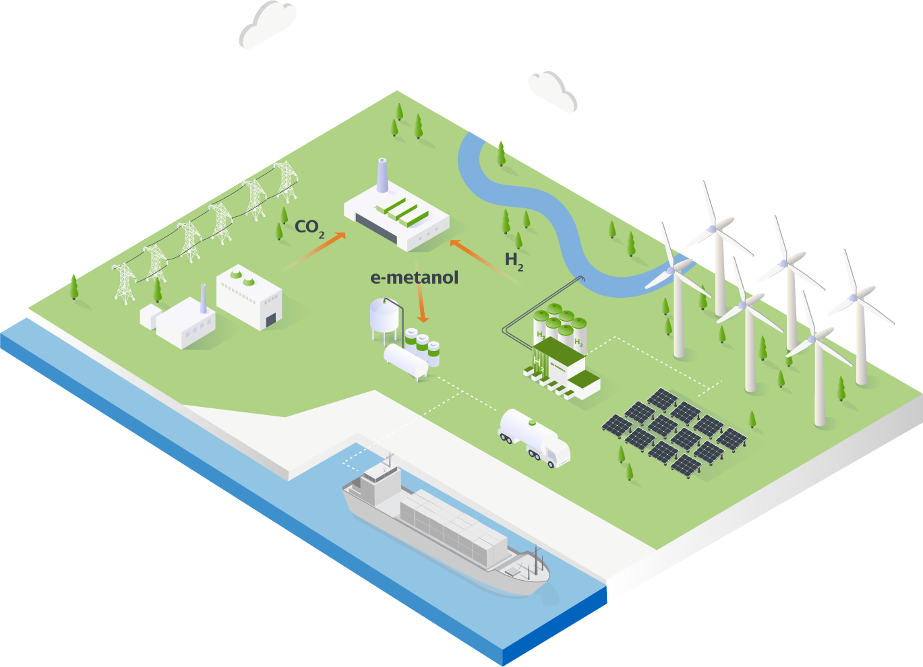
Green methanol plant

Slide 10
The methanol, as energy storage material
The output of renewable energy production (wind turbines, photovoltaics) changes significantly with time (exceptions are biogas and geothermal energy), therefore storage capacities are needed to overcome the low production periods in order to ensure the continuous electric energy supply. The feasible solution for energy storage is the use of diverse methods and capacities.
The chemical energy storing occurs nowadays mainly in batteries, but other methods of chemical storing are needed.
George Olah (Nobel prize winner 1994) and his coworkers, in their book about „Methanol Economy” discuss the options and vote for methanol as fuel and energy storing material.
According to their opinion methanol can be the alternative of hydrogen!?

Slide 11
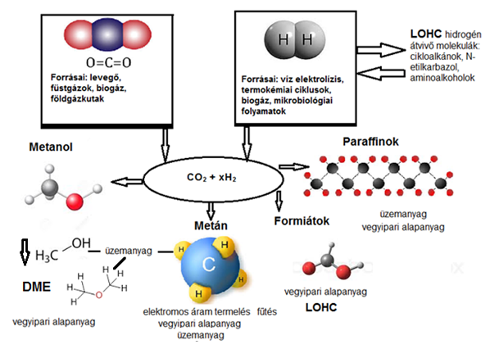
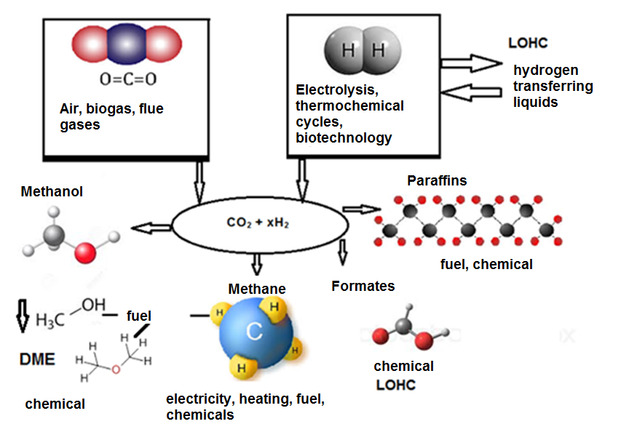

Energy storing materials
co
Formic acid

Slide 12
BME
Uses of the methanol
. As a solvent and as an antifreeze in pipelines.
. About 40% of methanol is converted to formaldehyde, and from
there into products as diverse as plastics, plywood, paints,
explosives and permanent press textiles.
. Large amounts of methanol is used to produce biodiesel (fatty acid methyl esters) and the gasoline additive octane enhancer, methyl tert-butyl ether (MTBE).
. Other chemical derivatives of methanol include dimethyl ether,
which has replaced chlorofluorocarbons as the propellant in
aerosol sprays, and another main product is acetic acid.

Slide 13
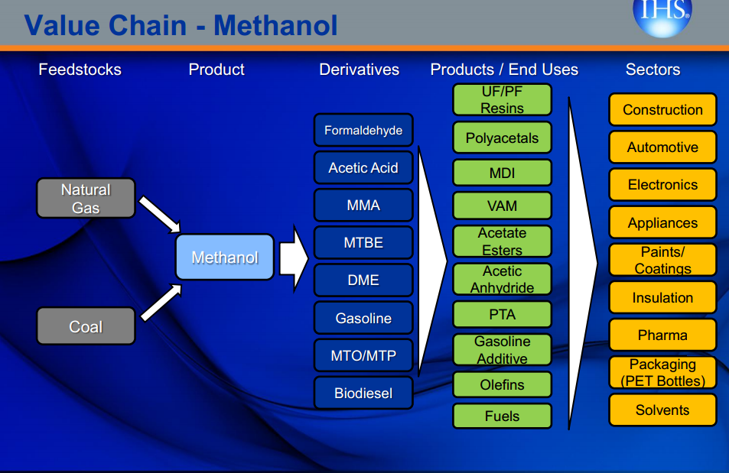
Green Hydrogen
CO₂ recovered

Slide 14
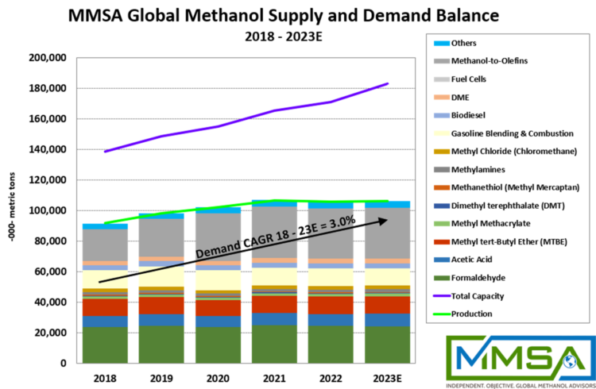
2023
Methanol Supply/Demand

Slide 15
BME
Methanol Production Processes
Methanol is currently produced on an industrials scale by catalytic
conversion of synthesis gas, mixture of H₂ and CO (CO₂). The processes are classified according to the pressure used:
1- High –pressure process 25-30MPa
2- Medium –pressure process 10-25MPa
3- low –pressure process 5-10MPa

Slide 16
      Main parts of methanol production plants
      1- Purification of raw materials.
      2- Steam Reforming of methane.
      3- Methanol synthesis.
      4- Methanol purification

Slide 17
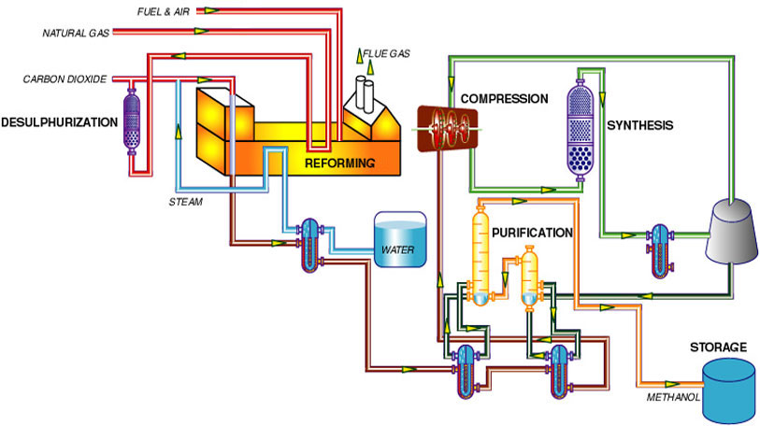
BME
Methanol Production Processes
2
1
3
      1- Feed Purification.
      2- Reforming.
      3- Methanol Synthesis.
      4- Methanol Purification.
4

Slide 18
BME
Synthesis Gas Generation
Today, synthesis gas is most commonly produced from methane, from natural gas rather than from coal.
At moderate pressures of 1 to 2 MPa (10–20 atm) and high temperature (around 850 °C), methane reacts with steam on a nickel catalyst to produce synthesis gas according to
CH₄ + H₂O = CO + 3H₂
This reaction, commonly called steam-methane reforming or SMR, is
endothermic.
The next step can be the CO conversion:
CO + H₂O = CO₂ + H₂
This is exothermic reaction.

Slide 19
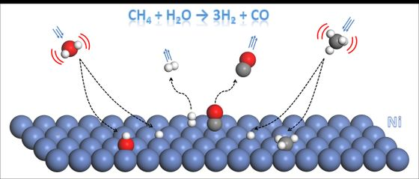
No. 2. Water gas-shift reaction of methane on Ni catalyst

Slide 20
Uhde radiation and secondary water-gas shift reformer
1) Gas introduction 2) burners, 3) reforming tubes, 4) outlet 5) air introduction, 6) catalyst bed 7) gas outlet
Reforming tubes contain Ni catalyst, pressure 10-20 bar, temperature ~850ºC

Slide 21
BME
Methanol Synthesis
There are two main chemical reactions (both are highly exotermic) which occur in this process step :
        CO + 2H₂ = CH₃OH
        ΔH = -91 kJ/mol ΔS = -220 kJ/mol
        CO₂ +3H₂ = CH₃OH + H₂O
        ΔH = -50 kJ/mol ΔS = -175 kJ/mol
Production of a crude methanol stream which is about 80% methanol and 20% water (from CO mainly!), carried out over Cu catalysts.
Crude methanol is separated from the uncondensed gases and the gases are recirculated back to the converter via the circulating compressor. Part of recirculated synthesis gas is blow down.

Slide 22
BME
Catalysts
. Catalysts for High-Pressure Synthesis
The first industrial production of methanol from synthesis gas
by the high pressure process employed a catalyst system
consisting of zinc oxide and chromium oxide, which was used
at 25-35 MPa and 300-450°C
. Catalysts for Low-Pressure Synthesis
All currently used low-pressure catalysts contain copper
oxide and zinc oxide with one or more stabilizing additives.
Alumina, chromium oxide or mixed oxides of zinc and
aluminum have proved suitable for this purpose.

Slide 23
BME
Type of reactors
Current industrial process for producing methanol differ primarily
in reactor design. Many different reactors are available, they may
be either adiabatic (e.g.,ICI) or quasi-isothermal (eg., Lurgi).
The ICI process accounts for 60%, and the Lurgi process for 30%
of worldwide methanol production.
. Quasi- adiabatic reactor: The ICI process uses an adiabatic reactor.
. Quasi-isothermal Reactors. The Lurgi process.

Slide 24
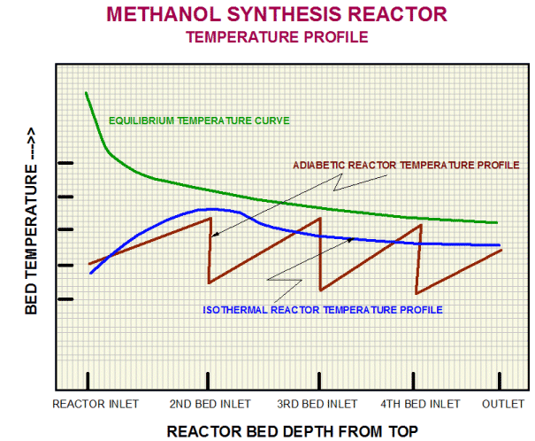
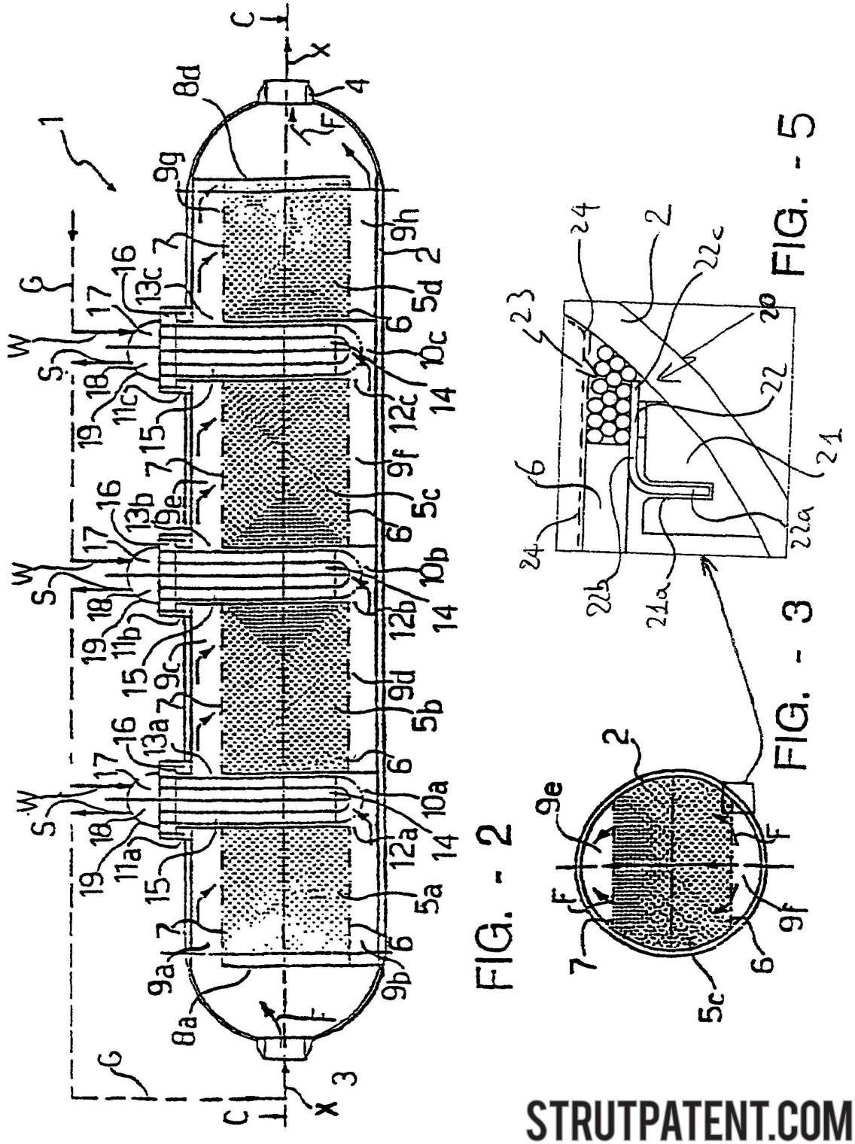
Reactor types
Quasy adiabatic reactor
Two solutions:
quenching (cold gas feed at intermediate points)
Catalyst bed sections with cooling in between
Stepwise adiabatic reactor

Slide 25
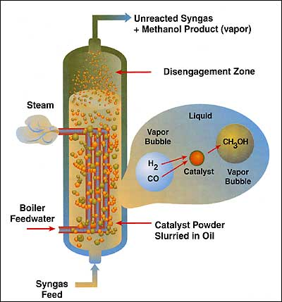
Quasi isotherm reactor Lurgi process

Slide 26
Green methanol from CO₂ by catalytic hydrogenation

Slide 27
Problems to be solved in the catalytic methanol synthesis starting from CO₂
There is a significant water level at the outlet of the reactor bed, which in turn has implications for decreased catalyst activity and lifetime, catalyst modifications including new support (ZrO₂, CeO₂) and promoter materials (Mg, Ga, In, Ni).
Clean hydrogen production from sustainable sources (probably wind-generated electricity in northern Europe, solar in desert locations) via electrolysis.
CO₂ recovery from different sources
Heat recovery (from intermediate condensation of the product). This is utilised very differently from a conventional plant and may have to be exported from the site (e. g. local domestic), depending on its level of integration within the plant itself or into other on-site processes.

Slide 28
A new route: low pressure methanol synthesis, the feed is from the dry+wet-reforming of biogas, the hydrogenation has two steps, with addition of an aliphatic alcohol

Slide 29
Electrochemical methanol production possibilities from carbon dioxide

Slide 31
BME
    Storage
    In totally enclosed equipments, tanks
    Avoid ignition and human contact
    Tanks must be grounded and vented and should have vapor emission controls.
    Avoid storage with incompatible materials.
    Material Selection for storage tank
    Anhydrous methanol is non-corrosive except:
    Lead, magnesium
    Methanol containing water is non-corrosive except:
    Lead, aluminum
    Mild steel is the recommended construction material.

Slide 32
Environnemental Protection
BME
Biodegradation / Aquatic Toxicity:
Methanol biodegrades easily in
  Water.
  Soil.
Methanol in high concentrations (>1%) in fresh or salt water can have short-term harmful effects on aquatic life within the immediate spill area.

Slide 33
BME
Thank you for your
attention!

